Slide 1
PD Reporting and the October Snapshot
Bringing the Data Together
Notes:
Welcome!
Collaborative, sharing environment
Intros, who’s here, who has what role in their district

Slide 2
October Snapshot / BEDS Day Snapshot 2017-2018
October Verification Reports are special education reports which contain data captured on BEDS day (first Wednesday in October) and require certification in the PD system in early January.
VR’s 1-9 are collectively known as the October Verification Reports (PD site), October Snapshot (Frontline IEP), or BEDS Day Snapshot (Level 0).
VR’s 1-6, and VR 8 are Verification Reports for data that is populated through SIRS.
VR 7 and VR 9 need to be reviewed, but are not officially certified.
Notes:
REFER TO HO #1 – Blue VR reporting Chart (which data is included in each report)
What is October reporting – series of reports broken down by CSE and CPSE which report certain data specific to those populations.
We will only be looking at the data that populates for the VR1-6, 8 during this workshop.

Slide 3
DATA SYSTEMS OVERVIEW and Included Data Elements

Slide 4
L1>L2RPT Error report
Notes:
Get your DB’s ready – login to the sites you have access to L0, PD, Frontline
Merger of data from two different systems. How it come together, going to the chapel and gonna get married
Daron – how it flows and how errors happen. touch on some common errors – time after to work on particular errors you are encountering

Slide 5
Required Student Data Source: SMS
Enrollment codes include:
Building of Enrollment (location where student is attending)
Enrollment Types:
PS: 0011, 5905
SA: 0011, 0022, 5905, 5544, 5644, 7000, 7011
Demographics include:
DOB, Gender, Ethnicity
Program Facts – ELL is included in the PD reports
0231 ELL Eligibility (formerly known as LEP)
3
Notes:
REFER TO BLUE CHART (HANDOUT #1)
What is included?
Building of Enrollment – where is the student attending? B1, B2, Mary Cariola, private school. Equals Location Code in Level 0

Slide 6
Required Special Education Data Source: Frontline IEP
October Snapshot Extract
REPORTS: Classified students aged 3 – 21 yo on BEDS day, with a program or related service spanning BEDS day
October Snapshot extract includes these data elements:
CPSE: PS (3-4 yrs):
Primary Service Code (SVC01 - SVC12 codes)
Primary Service Provider (Location BEDS code)
Pre School LRE Setting (PS04 - PS12 codes)
CSE: ESA (4-5 yrs not attending K, or 4 who is attending K) & SA (6-21 yrs):
Early School Age (ESA) LRE Setting (ESA01 - ESA12 codes)
School Age (SA) LRE Setting (SA01 - SA10 Codes)
Primary Placement Type (PLC01 - PLC03 Codes)
Notes:
REFER TO BLUE CHART (HANDOUT #1) and Handout #3 (Oct SS Frontline Guidance)
GOLDEN RULE of WHO’s INCLUDED on the Oct SS

Slide 7
Required Special Education Data Source: Frontline IEP
Program Fact: Type of Disability extract Codes include:
Preschool Age (PS): 5786
School Age (SA): 0352, 0363, 0385, 0396, 0407, 0418, 0429, 0440, 0451, 0462, 0473, 0484, 0495
Notes:
REFER TO DATA VERIFICATION REPORTS HO #3

Slide 8
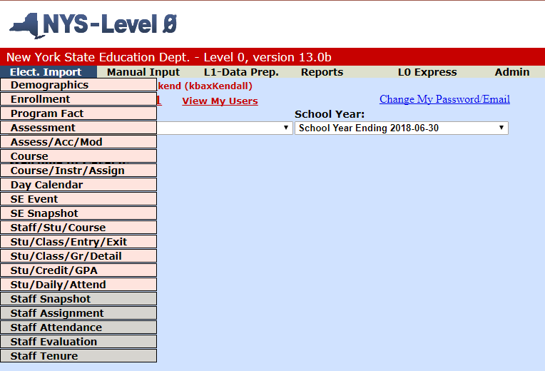
Data Uploaded to DW

Slide 9
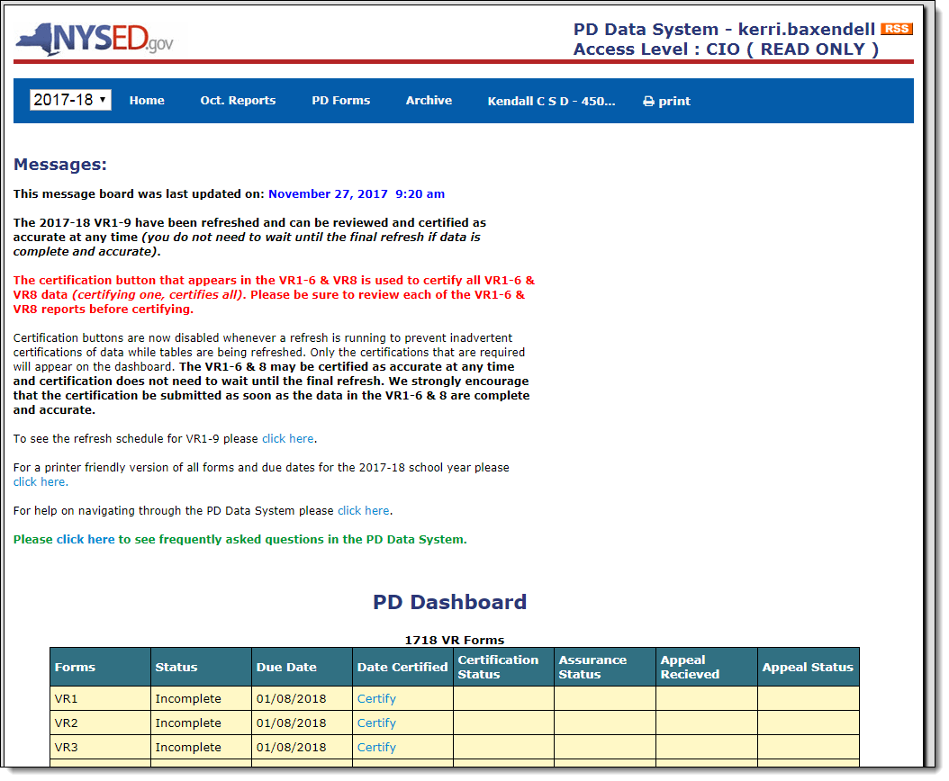
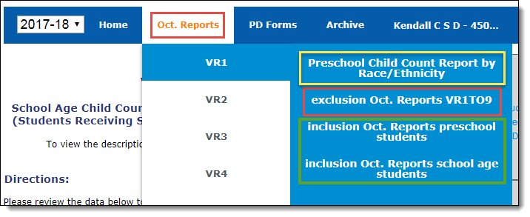
PD Data System Where it all ends up!
1
Notes:
Login if you have access
NOTE: click on CERTIFY to show that it will give you the breakdown of the numbers for each. Clicking on the number will take you to a list of students included for that particular data point

Slide 10
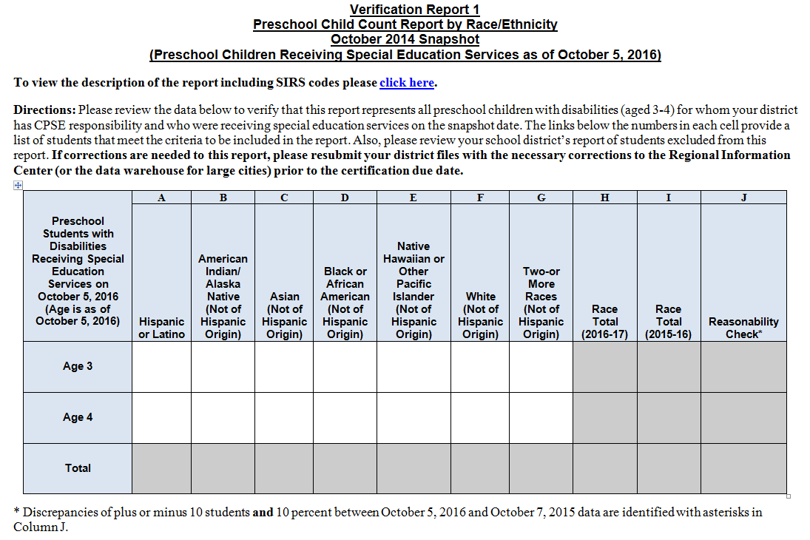
Sample Form: VR 1 Preschool Child Count by Race/Ethnicity
Notes:
This is the same view you see in the PD site when you click the Certify link for a particular report. Click on the numbers to see the list of students included in that detail.

Slide 11
Reports on PD Site How data is displayed
1
State Reporting Information Fields contained in Frontline IEP, and how the populate the October Snapshot extract in the PD Data System
Notes:
DEMO PD LIVE: How to read report area – Login if you have access and want to follow along – hover shows info
For CSE students – the Primary Placement Code in PD site = Primary Placement Type in IEP. This only populates for students who are court or State agency placement, or article 89 for residential or day placement.
PS Student Translations:
Primary SETTING Code = LRE Setting (for example: Regular Early Childhood program)
Primary Service Provider SED Code = (ex: BOCES 1, Mary Cariola) NOTE:!! This is also Location Code in Level 0; these need to match between SMS and IEP – If student has a change in their Primary Service Provider, need to share that with Registrar won’t give an error
Primary SERVICE Code = Primary Services Program (half day Special Class integrated, for example)
School Age:
Primary SETTING code = LRE setting for SA students (ex: Inside regular classroom for more than 80% of the day)
Primary Placement Code = Primary Placement Type in IEP. Don’t be alarmed if this is blank – indicates if the student is a court or State agency placement, or article 89 placement for residential or day placement.
For CSE students – the Primary Placement Code in PD site = Primary Placement Type in IEP. This only populates for students who are court or State agency placement, or article 89 for residential or day placement.
NOTE: click on CERTIFY to show that it will give you the breakdown of the numbers for each. Clicking on the number will take you to a list of students included for that particular data point

Slide 12
WHO is doing WHAT in your District?
Who is pulling the October Snapshot Extract in Frontline IEP?
Who is reviewing the reports in Frontline IEP?
Who is reviewing reports on the PD site?
Notes:
Now that we know the systems involved, and all the different data and where it comes from, who does what? What does this look like in your district?
Send or retrieve extracts?
What data systems do you have access to?
Who reviews the reports in each system? Exception, Excluded, Included? Are they shared with other departments, ppl touching the data?

Slide 13
Getting the Data to the PD is a PROCESS!
Verify the DETAILS of each report
Upload the Data!
Fix EXCEPTIONS seen on Frontline IEP report, or ‘pink’ cells on extract
GOAL: CERTIFY!!
Use reports to confirm Exclusions and Inclusions
Check errors in Level 0 – communicate with SPED
Notes:
Suggested order of operations involves both departments communicating: Establish process within your department as well.
Exclusions in IEP will avoid Level 0 Import errors!
Confirming Exclusions first in both the PD and Frontline is easier because the populations are smaller
Confirming that all students that are included SHOULD be included, demands a little attention on the SPED side
Once you know all are Included properly, then you can check the details of each report (review of certain details while reviewing the Inclusions is easier for some data elements, such as gender and race. However, with Centris Sync districts, this isn’t usually an issue.

Slide 14
Frontline IEP Reports
Exception
Inclusion
Exclusion
Notes:
Suggest starting with the Exception Report - Students who meet main inclusion criteria, but are missing one or more data elements.

Slide 15
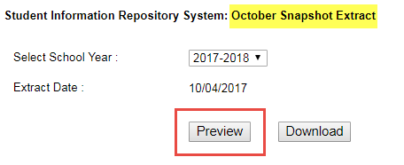
SNAPSHOT EXTRACT: A Quick View of the Exceptions
PREVIEW the Export in Maintenance:
Can Download the extract without Previewing; Be sure to preview for PINK prior to selecting Download.
Notes:
Who is checking the export in your district? Who is ‘pulling’ the extract? Are they checking it first?
Can Download without PREVIEWING, unlike the EOY extract.
Enter the data still seeing Pink? Have you entered the data in to the IEP that spanned BEDS day?

Slide 16
SNAPSHOT EXTRACT: A Quick View of the Exceptions
PREVIEW the Export in Maintenance: Take a QUICK view and look for the PINK {Data Missing} fields
RADAR: Multiple documents in the same school year
Be sure to enter the data on the IEP that was in effect on BEDS day.
Notes:
Who is checking the export in your district?
Enter the data still seeing Pink? Have you entered the data in to the IEP that spanned BEDS day?

Slide 17
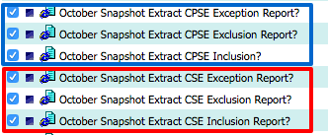
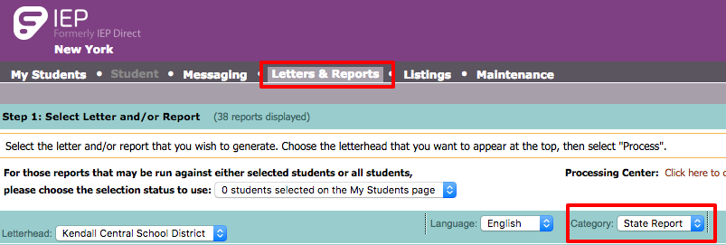
Frontline IEP – Verification Reports
EXCEPTION report
Check before you give the October Snapshot extract to your data warehouse person!
EXCLUSION report
INCLUSION report
Notes:
Who has run these reports? Here’s how if you haven’t.
Run and save to your computer now if you’d like -

Slide 18
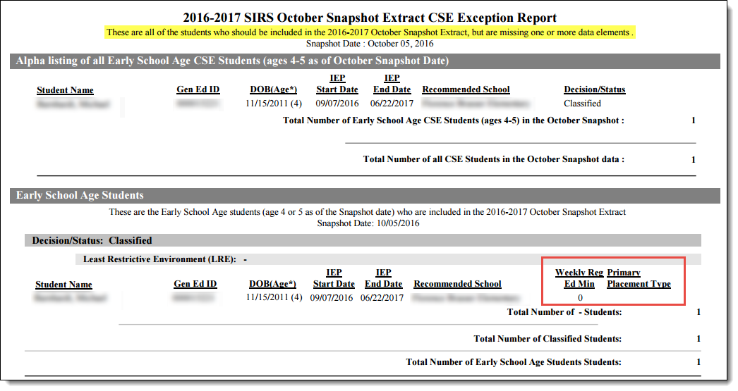
EXCEPTION Report – Frontline IEP
Students who meet main inclusion criteria, but are missing one or more data elements.
Communicate if the report has been reviewed!
This is the data that would show pink {Data Missing} fields in preview mode of the October Snapshot Extract. Also check that the LRE minutes have been calculated.
Notes:
HO #3 – Oct SS Export Frontline Guidance
SPED should be reviewing Exception report before giving extract to DW!
REFER TO HO #3: Descriptions of what is contained in that field can be useful when reviewing these reports
Example of data missing here: Primary Placement Type

Slide 19
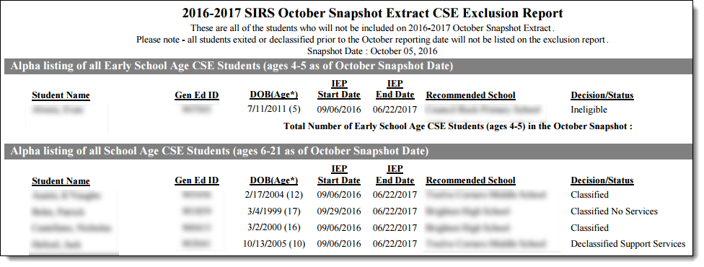
EXCLUSION Report – Frontline IEP
Run report for both CSE and CPSE
Check the Start of the IEP
Check the Decision Status – Verify!
Note: Classified students without Programs & Services that span BEDS day will be on the EXCLUDED report.
Notes:
Report shows all students whose IEP’s were in effect on BEDS day, but do not have one of the D/S values specified (will review in slide 19)
Students exited or declassed prior to BEDS day will not be on the Exclusion report.

Slide 20
INCLUSION Report – Frontline IEP
Run report for both CSE and CPSE
Can group CSE by Decision Status, or LRE category
CPSE & CSE: Check different LRE Types
CPSE: Check Primary Service Provider & Code
CSE: Check D/S and Primary Placement Type (if applicable)
5
Notes:
Student on their report will have all the info needed to be included, but are they in the right categories?
CINDI HANDOUT – Review details of the criteria in this handout – Also available on the SED website (click link what is your internal SPED process for entering the info?
GOLDEN RULEE!! At the core of being included is a student’s Decision Status. The extract looks at the latest finalized document that spans BEDS day, so if the IEP document is in error, student may report when they shouldn’t, or vice versa. Check if multiple documents in the same year have the correct information.
CPSE – comprehensive list, then broken down by LRE, Primary Service Provider, and Primary Service Code – Review the students on each of these lists.
CSE – comprehensive, then broken down by D/S or LRE Category, whichever you choose.
(Reminder:) Primary Placement Type for CSE students only populates for students who have a court or State agency placement, or are article 89 placement for residential or day placement. PLC02, or PLC03 (ex: would be SOTHC, Hillside Halpern)

Slide 21
PD Reports
Inclusion
Exclusion
https://eservices.nysed.gov/pdsystem/

Slide 22
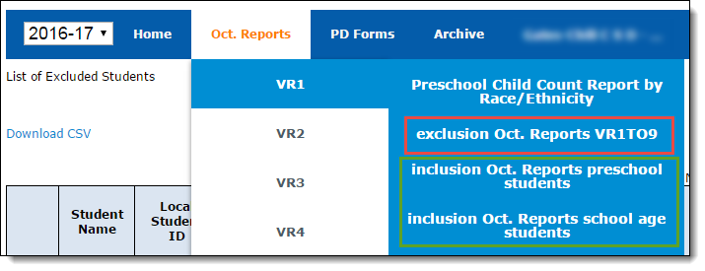
PD Site – Verification Reports Exclusions
DATA is MISSING
No Special Education Snapshot record
No Type of Disability Record
No active enrollment record
Younger than 3 on BEDS day
Did not have services or programs that span BEDS Day
Notes:
How to run reports in PD – walk through
Exclusions show 2 yo’s – Non Sync districts might want to confirm the DOB

Slide 23
PD Site – Verification Reports Exclusions – Missing Data
Student does not have October Snapshot record – WHY?
Check the EXCEPTION report in Frontline IEP – Is there data missing? Will throw an error on import into Level 0.
Did the student exit special education?
RADAR: Students aged between 18-21 (Ungraded Transition students) Did they show up for their programs in the new school year? Confirm the exit date.
Notes:
The PD Exclusion report flags students who have some of the data elements, but not all required for reporting.
Oct Snapshot can be exported from Frontline even though data is missing!! Do not take a file that has data missing because you will get errors upon import into Level 0. Import errors due to missing Snapshot records mean that the export was missing data.
Check with your Data Coordinator – did they have trouble with the import and remove error students? Make sure to follow up.
Data folks will need to communicate with SPED folks if they encounter errors upon import into Level 0 – Don’t just remove student from import without following up with SPED folks.

Slide 24
PD Site – Verification Reports Exclusions – Missing Data
Type of Disability Record is missing – WHY?
Newly classified - Has document been finalized?
Level 0 import errors - CPSE to CSE summer enrollments
No active enrollment record – WHY?
Does student have a code that includes them? (refer to slide 28 for inclusion rules)
Check enrollment type - Consult SIRS Table of Reporting Responsibility for enrollment scenarios
Notes:
Maybe a matter of timing from when the student was classified, to when the data was uploaded and populated through to SIRS

Slide 25
Included or Excluded? How do I know?
Inadvertent data entry errors in the IEP may cause data to be included or excluded when it shouldn’t be.
Confirm your data in Frontline IEP by checking these common offenders that can slip through the cracks:
Drafts - New and Transfer Students
Entry / Exit Dates
Decision Status – Classified No Services
Notes:
Going to verify Included by checking Exclusions (error tracing and missing data), and by checking data points to ensure all students have been captured correctly.
You’ve already reviewed your Exception, Exclusion, and Inclusion reports - and If you have a smaller district, you may be able to eye-ball your students reports and review if the basic inclusion data applies to that student. However, if you are working in a larger district, it’s much harder to know the situation or details of each student. How can you check to see if all students are included that should be, and vice versa?
We have some tips on areas to look at, based on previous experience in working with the extracts.

Slide 26
Which Students are Included in the October SS Extract?
Classified CSE and CPSE students with an IEP that is in effect on BEDS day (10/4/17), with programs and/or related services with dates that span BEDS day.
CSE Decision/Status | CPSE Decision/Status
Classified | Classified Preschool
Classified - Charter School Enrollment | Court or State Placed - Out of State
Classified - Charter School Dual Enrollment
Classified - PP within District Dual Enrollment
Classified - PP Non-Resident within District - Dual Enrollment
Court or State Placed - Out of State
Classified PP in Other Public School District
Classified Non-Resident within District - No Services
Classified PP within District - No Services
Notes:
GOLDEN RULEE!! At the core of being included is a student’s Decision Status. The extract looks at the latest finalized document, so if this document is in error, may report when it shouldn’t, or vice versa.
Always come back to this chart to help you determine if a student should be included based on their D/S.
REFER TO HO #4: FRONTLINE IEP DECISION STATUS GUIDELINES CHART
REVIEW: RADAR: Parentally Placed students can give people a headache, etc. refer to the chart when working with students who may have classification scenarios you aren’t sure of and whether or not they are reported.

Slide 27
Which Students are Included in the October SS Extract?
FOR REVIEW: INCLUDED: Classified students aged 3 – 21 yo on BEDS day, with a program or related service spanning BEDS day
CPSE: PS (3-4 yrs):
Primary Service Code (SVC01 - SVC12 codes)
Primary Service Provider (Location BEDS code)
Pre School LRE Setting (PS04 - PS12 codes)
CSE: ESA (4-5 yrs) & SA (6-21 yrs):
ESA LRE Setting (ESA01 - ESA12 codes)
School Age LRE Setting (SA01 - SA10 Codes)
Primary Placement Type (PLC01 - PLC03 Codes)
Notes:
What do these fields mean? Refer again to HO #3

Slide 28
Tips for Checking your Data
These are some RADAR AREAS to look out for that can help you to confirm your data in Frontline IEP.
Please share any issues you’ve encountered in your district!
Notes:
Can tell you where we found errors, but exactly the actions that caused the errors, I couldn’t say because there are so many factors involved in the SPED process.
We wanted to include at least one tip on how to investigate this area in your data, but you may have your own process, suggestions or strategies. Please share!!

Slide 29
Know Your Student Population!
Radar Areas! Check these common offenders to help confirm your data
Draft Documents: Finalize any that span BEDS Day
Transfer Students: Students under review or re-eval
Enrollment date vs start of IEP and programs/services in your district
Decision Status: Drives inclusion on Oct Snapshot
Confirm documents have the correct Decision/Status. Example: Classified – No Services
Students who have Exited or Declassified don’t have a previous document that is including them
Enrollment Start/End: Confirm exit dates with data warehouse
Notes:
These are some of the areas where we’ve encountered issues after tracing back Inclusion or Exclusion errors with various districts. In some cases it was because of an error discovered in the verification process, in others, inaccuracies were discovered once the data was uploaded and being reviewed.
Merely suggestions of areas you could check anywhere in your process which can help with the integrity of your data. Some of these areas can overlap each other in certain scenarios – keep an umbrella view.

Slide 30
Radar Area: Check for Drafts
Have all DRAFT docs created before BEDS day been finalized?
SUGGESTION: Review the drafts created close to BEDS day
Students who have been recently classified
Students who transferred into the district
Finalize draft docs as soon as possible. Communicate with data warehouse if you have situations that are prolonging the finalization process for a student.
Notes:
Remember the Golden Rule of Inclusion: Classified students with an IEP in effect, and with programs or services that span BEDS day will be included on the October SS
Docs in DRAFT mode will not be included! Date of creation of draft before BEDS day, implies the potential for student to have an IEP and services that started before BEDS day. Would want to check this.
This is usually just a matter of timing between when doc was created, and meeting was held to determine start of services.

Slide 31
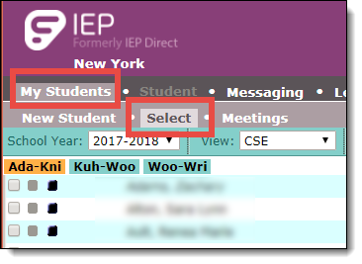
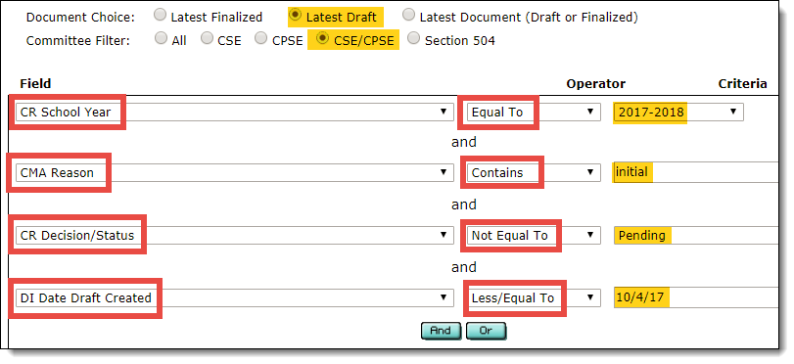
Radar Area: Drafts Finding Drafts of Recently Classified
One Strategy to find Recently Classified Students with a Draft Document:
Create a Select Query from the My Students page
Notes:
May already have your own listing to find recently classified, but can use Select Query to find any drafts created before BEDS day. These are the most likely to have students who may have services starting before or on BEDS day, so would need to be finalized.
Use Initial because these would be students who have recently been brought before the committees
Drafts for “Pending” students are excluded, since they have not yet been determined, and would not have a Decision Status
Date the draft was created would be up to and including BEDS day.

Slide 32
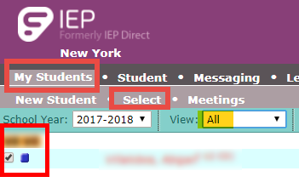
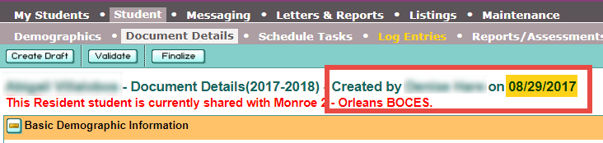
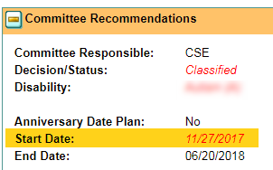
Radar Area: Drafts Finding Drafts of Recently Classified
Blue ‘chicklets’ are Draft docs
Where is the committee in the process?
If Start Date of IEP is before BEDS day, then check the date the programs or services are to begin.
If programs or services span BEDS day, finalize the document so it will be included on the extract.
Notes:
Draft start date before BEDS – clue you in to the intention of starting IEP and services prior to BEDS day
Drafts created prefill with the first and last day of the school year – check if these dates are still accurate, or if they need to change.
Although this Draft document was created before BEDS day, the student’s projected start date of IEP was after BEDS day, so student would not be included.

Slide 33
Radar Area: Transfer Students
Transfer Students – With or Without Meeting SUGGESTION:
Review both Draft and Finalized docs
Check progress of Draft – is it in the process of being finalized?
Does the student have 2 Finalized docs in the same school year?
Check start date of original accepted transfer document
Start date of original transfer doc can’t be before the date the student enrolled in the district – confirm enrollment start date with data warehouse.
Check Frontline Help for information on the Transfer Intake Process. Search terms: Transfer Intake
Notes:
When a transfer is accepted, it automatically becomes a DRAFT and the start dates default to the beginning of your school year. Important to make sure these dates get changed to no sooner than the date the student enrolled in the district.
Tip: Get a report of enrollment entries from SMS to CONFIRM start dates of previous transfer documents.
Depending on the time of year in which the student enrolls in the receiving district, the district's October Snapshot may be affected. It is important to finalize the draft document sent by the sending district as soon as possible after the student enrolls. This can ensure the student is properly captured on the October Snapshot as the district is providing services to the student and should be counted.

Slide 34
Radar Area: Transfer Students
One Strategy to Review Transfer Student Documents:
Create a Select Query from the My Students page and compare this list against Oct SS
CR School Year
CMA Reason > Contains > Transfer
CR Decision/Status > Not Equal To > Pending
Click name to see list of all docs in that SY
Notes:
Use Transfer student listing to compare to Oct SS students – missing or included?

Slide 35
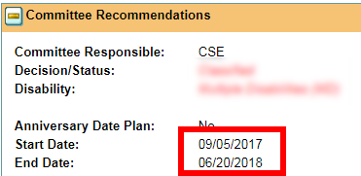
Radar Area: Transfer Students
Investigate the Chicklets!
Blue chicklets are Draft documents, Black chicklets are Finalized documents
If IEP Start Date of DRAFT is before BEDS day, then check on the progress to determine if student should be included on Oct SS – if yes, finalize the document with correct start date.
Remember to update the Start Date before Finalizing.
Start Date of IEP can’t be before the date student enrolled in the district.
Notes:
First thing I’m going to check in the Transfer list is all the Draft docs won’t report a student – Investigate if document would include student if finalized.

Slide 36
Radar Area: Transfer Students
Investigate the Chicklets!
Blue chicklets are Draft documents, Black chicklets are Finalized documents
Compare and contrast the list of Transfer students to the October Snapshot. Check for discrepancies between the lists.
Start dates of an earlier finalized document could be including the student accidentally - Confirm student enrollment entry date is on or before the Start Date of any Finalized docs.
Start Date of IEP can’t be before the date student enrolled in the district!
Student is on Snapshot; Review docs
After confirming enrollment start date, this student transferred over the summer and the student is correctly reporting on the Snapshot due to doc 7028. Would need to investigate why the earlier original document (6995) is still in Draft mode.
Notes:
Investigative research based on the chicklets, Start Dates, and Doc ID numbers
Contrast and compare -
Checking Transfer students against Oct Snapshot data – are students in your query on the snapshot, or missing from the snapshot?
I like to open all transfer students and check docs – sometimes catch other clerical issues that aren’t affecting snapshot, but would be good cleanup.
Sometimes can find other clerical areas that need attention while investigating.

Slide 37
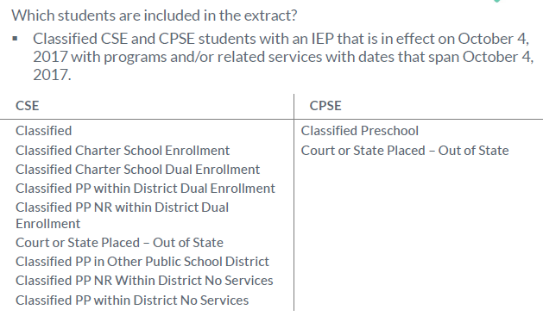
Radar Area: Decision Status
Check Decision Statuses
Review the students on Inclusion list – were all receiving services on BEDS day?
Students who are Classified, but not receiving services (ex: due to a provider shortage) need to be indicated as Classified – No Services, otherwise will report out on the October SS.
Remember the Golden Rules of Inclusion!
If you’re not sure of the criteria of the different Decision Statuses, consult the Frontline Decision/Status Crosswalk
Notes:
Don’t want to report students on snapshot that you are not responsible for.
Consult Decision Status chart if unsure of Parentally Placed criteria.
New doc with different services is created – first doc was not changed to reflect that the student was not receiving those services while that IEP was in effect. IEP could have a start date that spans BEDS day, and P/S that span BEDS day, but student isn’t actually receiving those services.

Slide 38
Radar Area: Decision Status
Check Decision Status of Included:
Has a student recently left the district, transitioned to CSE, or been Declassified?
Check students who were EXITED or DECLASSIFIED
If you know a student Exited, or was Declassified, but you’re seeing them on the snapshot, it may be they have an earlier document that is meeting the INCLUSION criteria.
SUGGESTION:
Create a listing in Frontline with dates of students who have EXITED Special Education, or were DECLASSIFIED.
Confirm students EXITED/DECLASSIFIED before BEDS are NOT on the Snapshot.
Notes:
Talk with data warehouse to get confirmation of enrollment exit dates for students who exited the district – SIRS exit reason: Moved, known to Continue

Slide 39
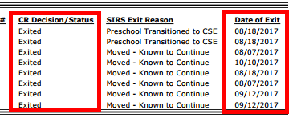
Radar Area: Decision Status
Checking EXITED from SPED Dates
Create a Listing of students EXITED from Special Education:
CR Decision/Status > Equal To > Exited
Check if Exit date is before BEDS day – should NOT be on snapshot
Exit dates on or after BEDS day mean student should be on snapshot
Notes:
SIRS exit reason: Moved, known to Continue
Talk with data warehouse to get confirmation of enrollment exit dates for students who exited the district –
Compare this list to SS – if student exited prior to BEDS day, but is on the SS, then you would have to investigate.

Slide 40
Radar Area #3: Decision Status
Checking DECLASSIFIED Exit Dates
Create a Listing of students who were DECLASSFIED:
CR Decision/Status > Contains > Declassified
Check if Exit date is before BEDS day – should NOT be on snapshot

Slide 41
Data Deep Dive!
Notes:
Much of what I’ve covered in the last few slides are strategies for folks to check their data, but basically using reports and then ‘eyeballing’ the data to compare and contrast.
If you feel confident working with raw data in Excel or Access, or have someone in your department that could help you, these Deep Dive suggestions are good for some preliminary raw data checks.

Slide 42
Tips to Compare the Data
Compare all INCLUDED in Frontline IEP to all INCLUDED in PD Data System (can find students that Level 0 edit checks don’t catch)
Use Excel to compare CSV files – conditional formatting: Find Unique
Use Access to run an ‘Unmatched Query’ – use the ‘Find Duplicates’ or ‘Find Unmatched’ wizards
How to get Extracts for Comparison:
In Frontline IEP: Maintenance > SIRS Extracts, choose: Data Verification Extracts > October Snapshot. Download both CPSE and CSE reports.
Notes:
Depending on your level of comfort with Excel or Access, these are some suggestions for comparing your Included files
Compare and contrast – what are the discrepancies? Investigate the student in Frontline – might be one of the Radar areas!

Slide 43
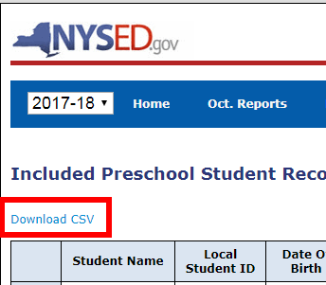
Tips to Compare the Data
Compare all INCLUDED in Frontline IEP to all INCLUDED in PD Data System
How to get Extracts for Comparison:
In the PD site: Download INCLUDED CSV file for both CPSE and CSE students.
Open any VR to select the Inclusion for Preschool Students or Inclusion for School Age Students.
Click the Download CSV link to download the data.
Will include all data you see on the screen, including student names.

Slide 44
Focus on the Details
Now that you are confident all students are included or excluded as necessary, review your PD report details!
Each VR report divides the data into different reporting categories.
Who is reviewing each report in the PD site?
Notes:
While in PD site, can review the Inclusion list for all the details
AND
Open each VR to review specifics of that reporting category
Department Chairs – get involved to help review the data!

Slide 45
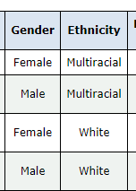
Focus on the Nitty Gritty
Demographics:
For non-sync districts, could have differences in gender, DOB, ethnicity in Frontline.
Primary Service Provider SED Code:
Comes from Oct. SS, but does it match the student’s enrollment location in the SMS?
Hover over the SED code to see the location associated
Compare data in PD to enrollment location data in SMS
Slide 12 details the data source for each column of information
Notes:
Hover over SED Primary Service Provider to see the Location
TALK POINT: Sometimes a student changes locations, but the info doesn’t get communicated with the Registrar. Request an enrollment report for all outside placed students from Data person to review Provider Locations.

Slide 46
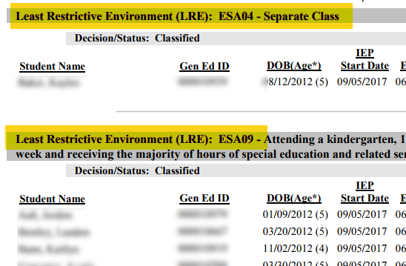
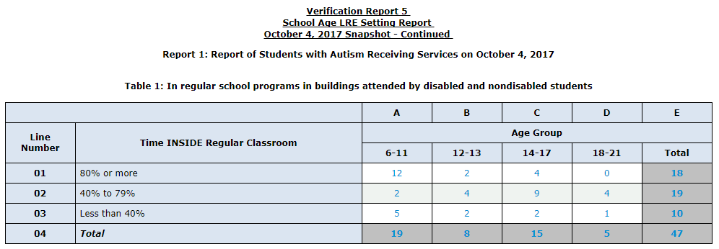
Focus on the Nitty Gritty
LRE:
VR Reports 4 (preschool age) and 5 (school age) detail LRE data
Frontline Included students report can be a helpful tool while reviewing LRE VR’s in the PD Data System.
Run Inclusion Report in Frontline > select LRE Category
Notes:
Primary Service Provider – only show the code, would need a crosswalk – Print this out of Frontline?
Run Frontline Inclusion and choose LRE Category
VR 4 – Preschool LRE
VR 5 – School Age LRE
HANDOUT #3 - Frontline Oct SS guidance doc w LRE scenario details
HANDOUT #6 – Cindi guidance Draft
TALK POINT: Sometimes a student changes locations, but the info doesn’t get communicated with the Registrar. Request an enrollment report from Data person to review Provider Locations.
IEP Scenarios and where to enter info into the State Reporting section of IEP
Data Verification Report in Frontline is available for CPSE and CSE.

Slide 47
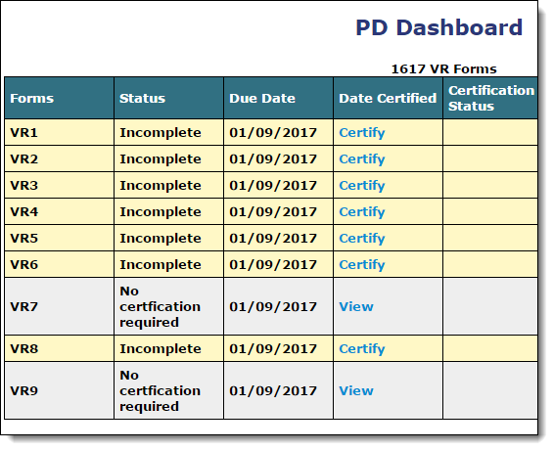
CERTIFY!
Certifying any one of the VR1-6 or VR 8 reports will certify all
Certify as soon as you know your data is ready
All data needs to be loaded into Level 0 no later than noon on the THURSDAY prior to the VR due date shown on the PD Dashboard page

Slide 48
WRAP UP: Tips
Create data team if you don’t already have one!
Create a timeline to start checking your Snapshot Data. Use due dates to plan data meetings.
Communicate early which PS students are not getting ESY – they need a ‘summer enrollment’ to prevent TOD import errors when Level 0 reopens in September.
Notified when a student exits the district? If you have access to Frontline, check if they are classified. Put them on your (October Snapshot) radar.

Slide 49
Resources / Links
PD Reporting Site (to access reports and to certify data)
VR descriptions and Instructions, including required data elements:
http://www.p12.nysed.gov/sedcar/forms/instructions/instructions1617.html
Special Education reporting requirements and data submission schedules (SEDCAR site):
http://www.p12.nysed.gov/sedcar/data.htm
Special Education Codes and Descriptions (Primary Service Codes, LRE Codes):
http://www.p12.nysed.gov/sedcar/sirs/sirs_toc.html
QUESTIONS?!! CONTACT US!! PDHelp@bocesmaars.org
Notes:
Workshop time!!

